Slide 1

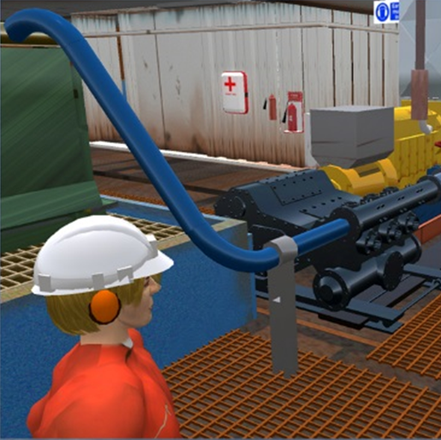
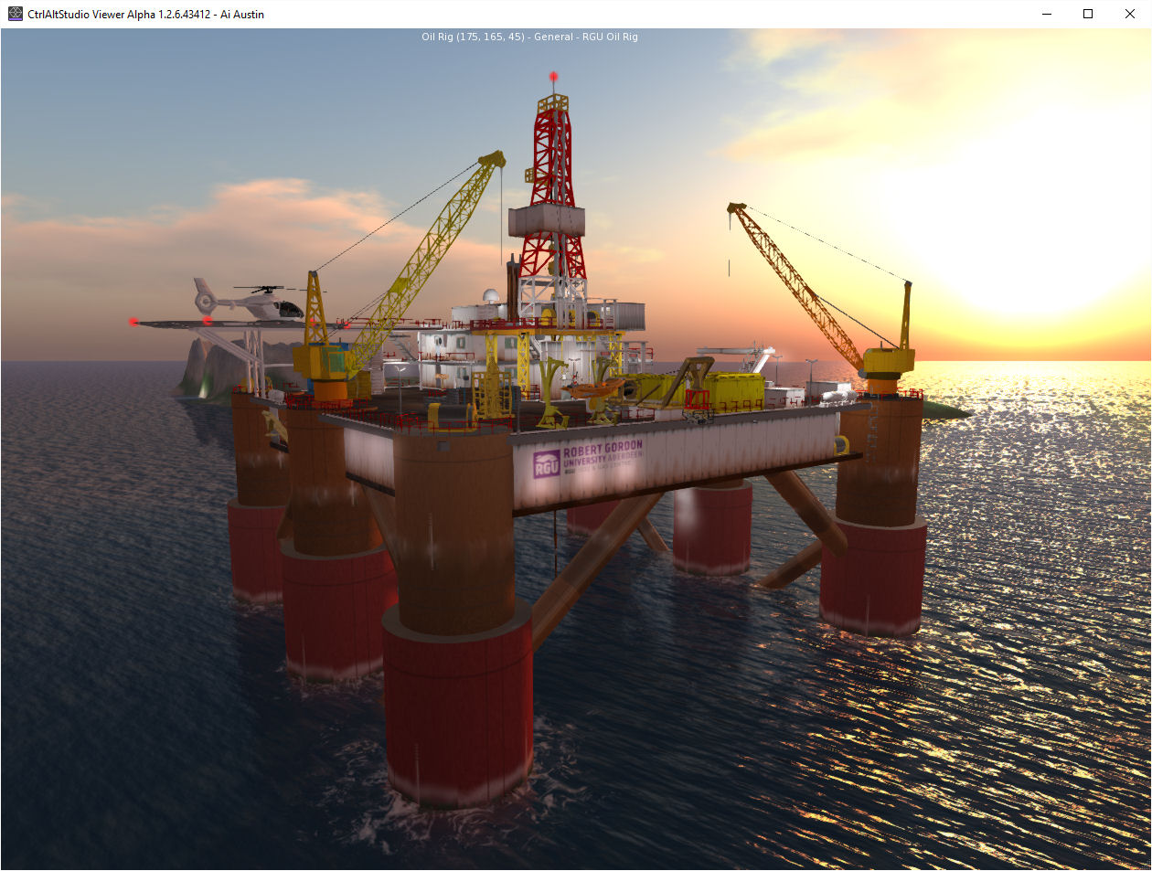
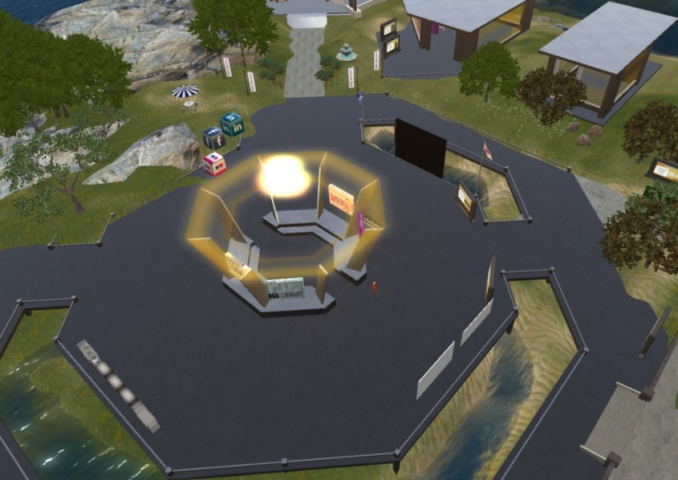
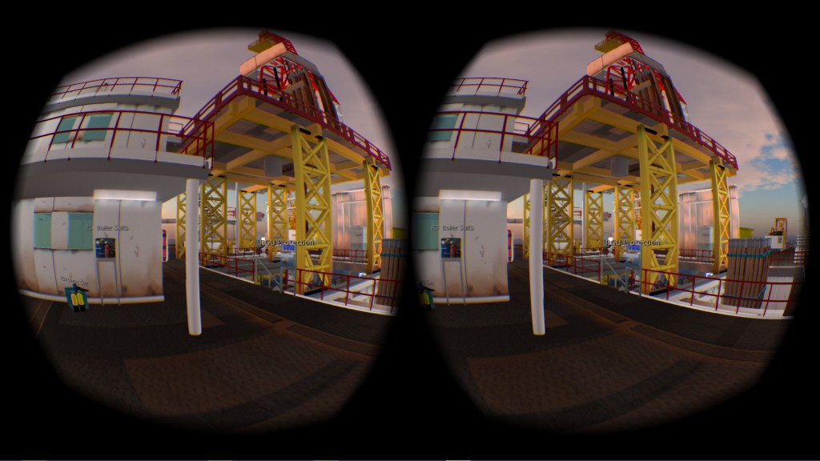
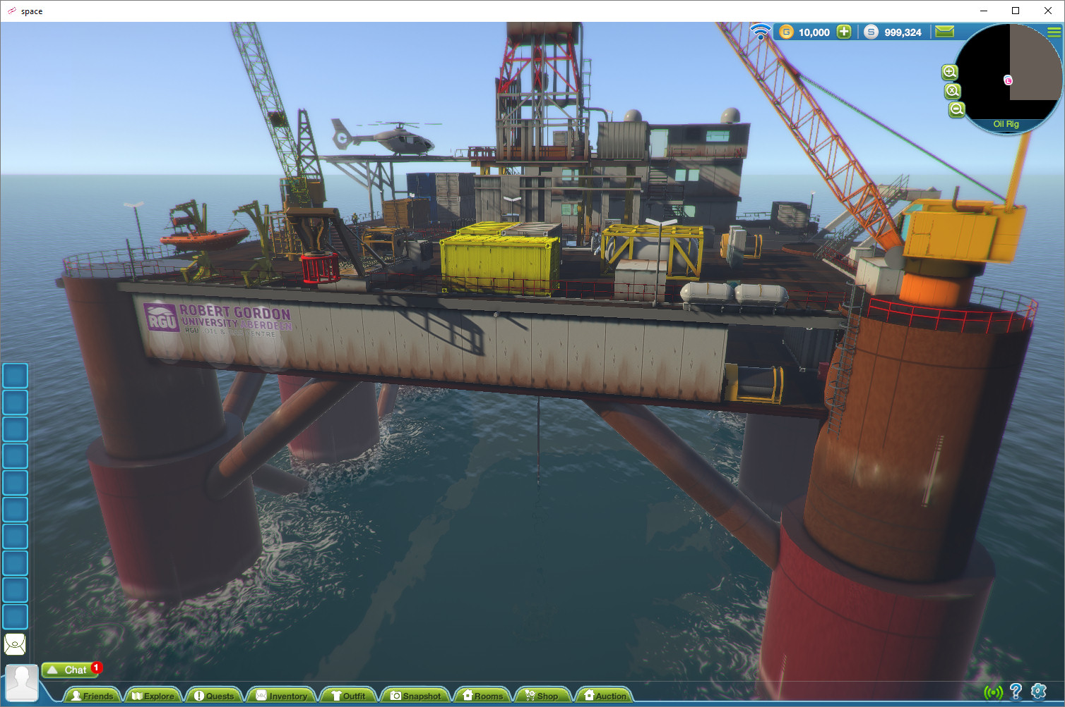
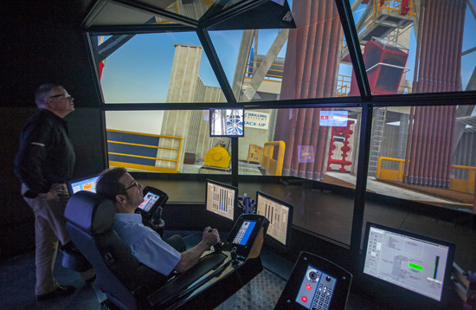
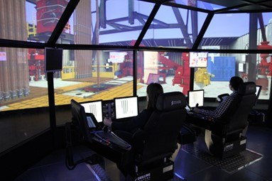
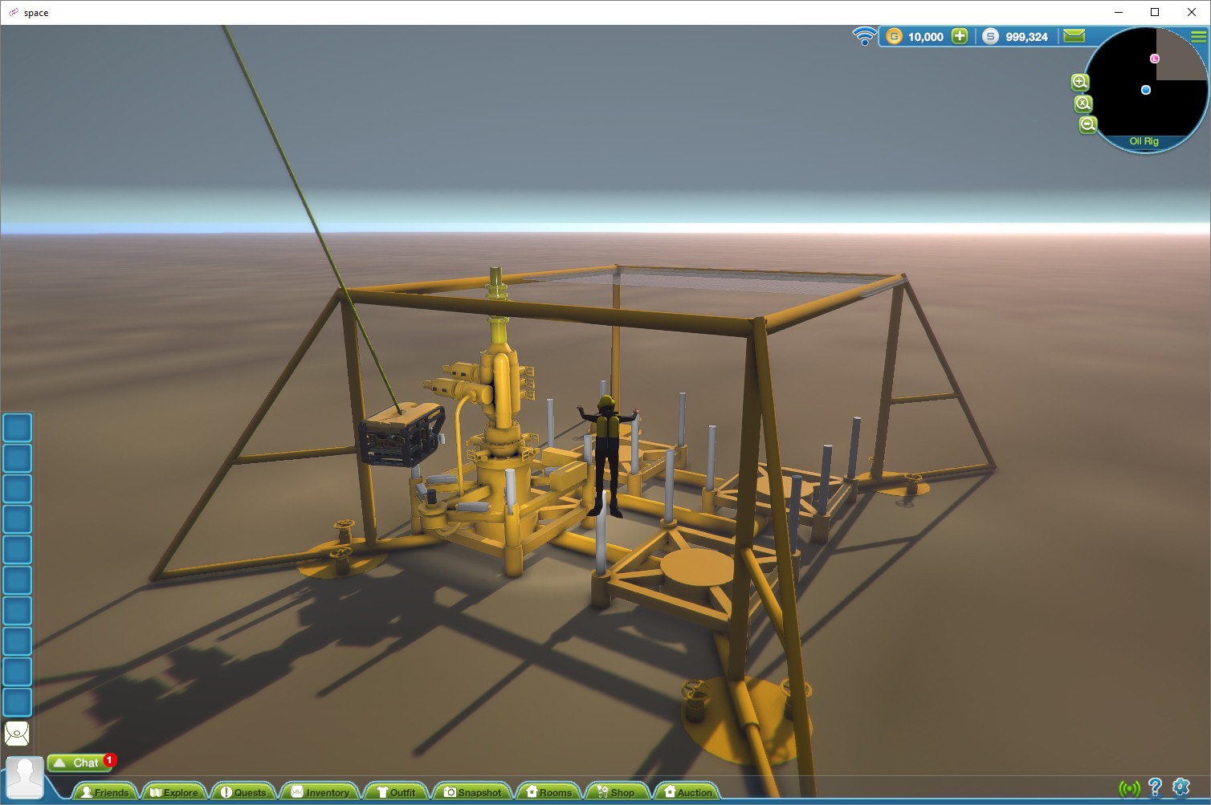
Enhancing Student Employability with Simulation: The Virtual Oil Rig and DART
Introduction
The School of Engineering at RGU has made significant investment in developing methods to ensure graduates are “industry-ready”. Two approaches are highlighted here. As visits to oil rigs are not often possible or practical for students it was decided to develop a virtual space for students to familiarise themselves with aspects of the offshore environment. In addition to this, the DART was installed on campus for simulation of a number of critical processes. These simulation tools give students experiences that can increase their desirability to employers.
The RGU Virtual Oil Rig, and Surrounds
Development of semi-submersible rig (Using OpenSim)
Set in ocean environment with sea life
Moving parts and sound
Buildings “onshore” to showcase posters/materials
Lecture Hall for live streaming events
Visitors click on objects for information and linked videos
Social areas for staff and students, (based on the OVC OAR*)
Collaboration – University of Edinburgh
Experimenting with porting the RGU Virtual Oil Rig via the OpenSim OAR Converter to Unity3D (available through http://sine.space/world )
Investigating use in virtual environments designed for use with VR headsets
DART - Dynamic, Advanced, Responsive, Training
Full-scale reproduction of offshore platform or land rig
Touch screen consoles for driller and assistant
3D graphics of rig drill floor
Equipment projected onto a 60ft cinema screen
Realistic, dynamic graphics and sounds simulating what the driller would see and hear on the rig.
Next Steps
Further integration into taught modules
Use DART and the Virtual Oil Rig for assessment of key skills
VR simulations with DART
Increasing student partnership
More Information and Image Sources
Virtual Oil Rig http://sine.space/world
DART http://www.rgu.ac.uk/student-life/virtual-tours/riverside-east/dart-simulator-virtual-tour/
Blog Featuring Rig: http://blog.inf.ed.ac.uk/atate/2017/01/24/sine-space-rgu-oil-rig-region-live/
Contact
Jo-Anne Tait: j.e.tait@rgu.ac.uk Colin Hetherington: c.hetherington@rgu.ac.uk Austin Tate: a.tate@ed.ac.uk
*Open Virtual Collaboration Environment Open Access Repository

