Slide 1
Agent-Based Architecture for Intelligence and Collaboration in Virtual Learning Environments
Punyanuch Borwarnginn
5 August 2013

Slide 2
Outline
Virtual Learning Environments
Problems
Baseline capturing (Survey results)
  Proposed solution
Intelligent Learning Environment
Evaluation
Plan

Slide 3
Virtual Learning Environments
  Web-based learning environments
  Support classroom learning
  Self-learning
Examples
  Blackboard WebCT
  Moodle

Slide 4
Problems
VLEs usually
lack of assistive feedbacks.
lack of providing personalisation and adaptivity.
lack of supporting collaborative tasks.
itself is not an automated system.
How do we improve VLEs to support these issues?

Slide 5
Baseline Capturing
Survey Results

Slide 6
Purposes
To understand a students' behaviour and a classroom style.
To capture current uses of an online learning environments that students use in their learning.
To evaluate the satisfaction of the current use in an online learning environments.
To be able to use these data as orientation data for establishing issues and requirements of the project.

Slide 7
Data collection
Questionnaire
Faculty of Information and Communication Technology, Mahidol University, Thailand
  11 Lecturers (44%)
  283 1st-3rd Undergraduates
    valid answers : 277 (40.67%)

Slide 8
What kind of learning could best describe the students’ learning behavior?
Students
Lecturers
N= 272 ,No answer = 5

Slide 9
Which style of classroom could describe your class?
Students
Lecturers
N= 274 ,No answer = 3

Slide 10
Have you experienced any issues or problems according to this learning behavior and classroom styles?

Slide 11
More details
Lecturers 'views
Not all students were interested in the activities.
Students pay no attention.
Students’ views
The attention span of students is in general quite short
Sometimes students want to know why we should learn this subject and If we study well in this subject what can we use benefit (useful) from this.
Students did not participate with teacher as it should be.
Lack of resources for teaching.
Some subjects have many lessons and very board then we want some activities for making we active to learn.
Some subjects are difficult to explain in lectures. Other learning activities could make them easier.
Students have different backgrounds, profiles, learning styles and knowledge about their subjects.

Slide 12
Have you ever used learning management systems (LMS), virtual learning environments (VLE), e-learning systems or course websites?
Lectures
  100% Yes
Students
  89% Yes (247)
  11% No (30)

Slide 13
Frequency of use in different features (Students)

Slide 14
Frequency of use in different features (Lecturers)

Slide 15
Features Ranking
Lectures
Upload course materials
Setup assignment
Create course announcement
Questionnaire
Setup quizzes
Discussion Forum
Wiki
Chat room
Students
Download course materials
Submit assignment
Check course announcement
Questionnaire
Take quiz
Wiki
Discussion Forum
Chat room

Slide 16
I am satisfied with the current system that I am using.

Slide 17
Suggested Improvements
Lecturers’ views
Interactive lesson that allows teachers to incorporate formative assessments into course materials.
Dynamic web modules for observing student assignments, performances, and easing up grading processes.
More interactive features
Better User Interface
Pool of videos (may be imported from Youtube) categorized by its subjects with a search 'feature'
Multiple templates of Quiz and Scoring systems

Slide 18
Suggested Improvements
Students’ views
More functions for supporting collaborative tasks such as group projects.
Video Lectures
More social network integrations
Search engine
More contents and activities in Wiki and Forum

Slide 19
Proposed Solution
Hypothesis
Integrating well-designed agent-based systems can enrich the intelligence responses (adaptivity, personalisation and task monitoring) during the learning process in the virtual learning environment that lead to the better learning experience.

Slide 20
Proposed Solution
Outcome
Agent-Based Architecture for Intelligence and Collaboration in Virtual Learning Environments called “Intelligent Learning Environment” (I-LE)

Slide 21
Intelligent Learning Environment

Slide 22
Objective
To introduce an agent-based system into a Virtual Learning Environment
To personalise and adapt learning materials and activities based on students’ profiles and preferences.
To observe students’ assignments, group progresses and their performances.
To assist teachers when it needs their attention.

Slide 23
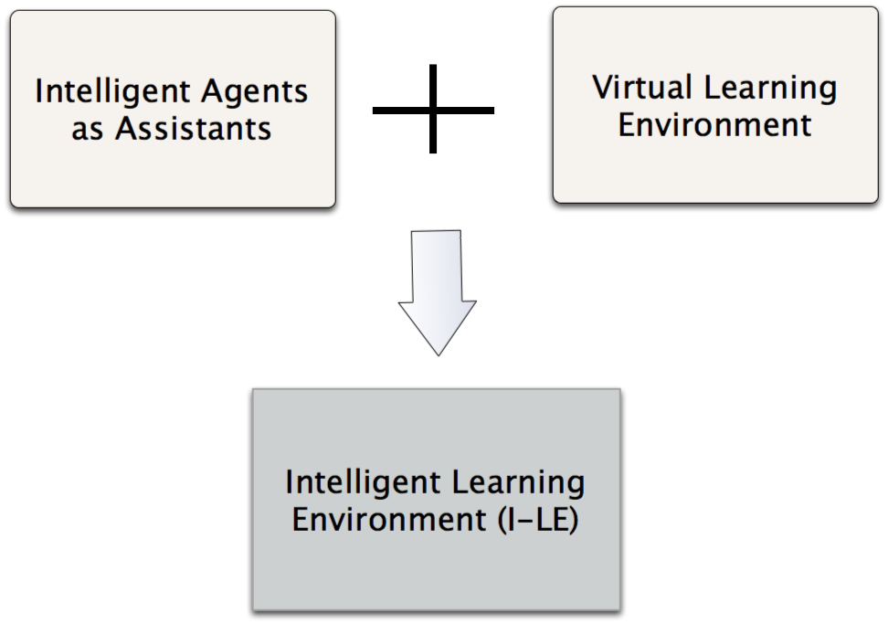
Intelligent Learning Environment

Slide 24
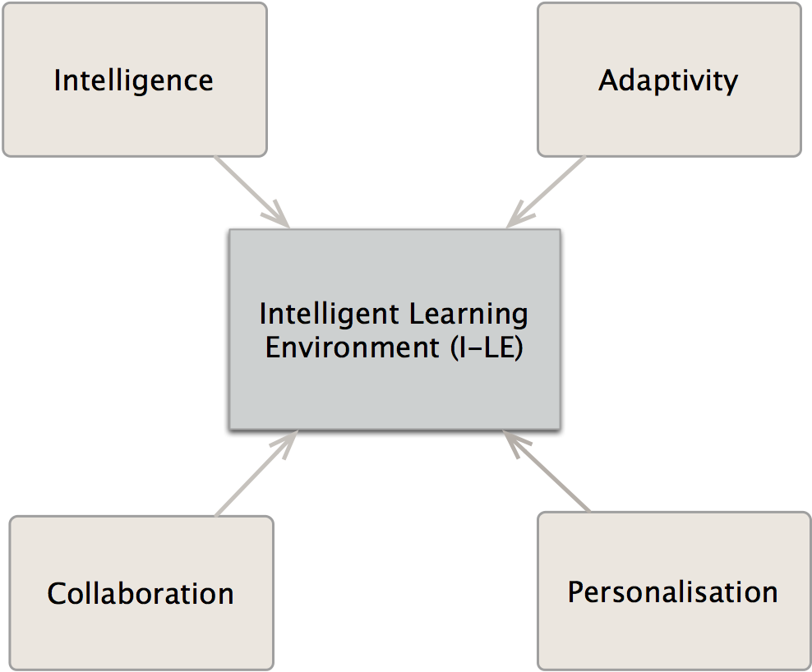
Aims

Slide 25
Agents
Profile Agent
  Collect and Update student data
  IMS Learner Information Package
Student Agent
  Recommend a student to perform activities
  Suggest students to learning resources
Activity Monitor Agent
  Monitor student activities by using state changes
    Student A has created a report B → hasCreated(StudentA, ReportB)
    Report B is reviewed by student C → isReviewed(ReportB, StudentC)
Teacher Agent
  Notify teachers about students progress
  Notify teachers when to review and mark assignment

Slide 26
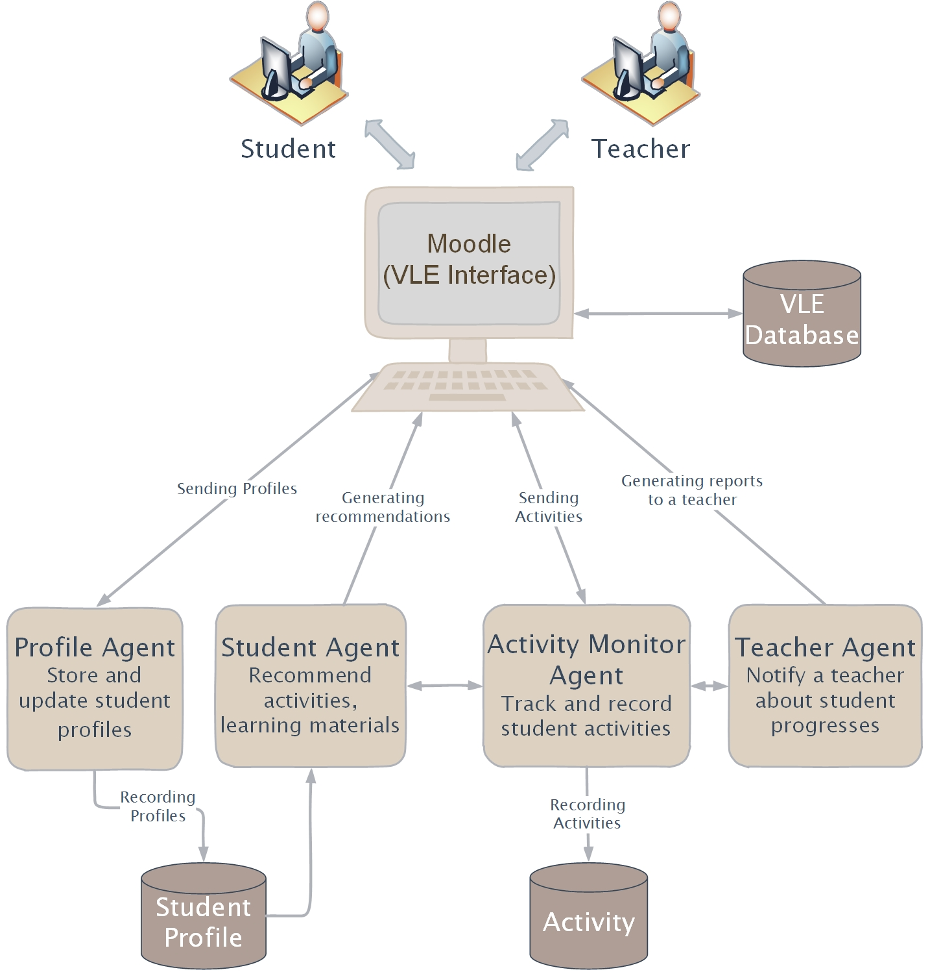
Overview of I-LE

Slide 27
Experimental Design
Phase I: Baseline capturing
Phase II: Pre-experiment
Phase III: Post-experiment

Slide 28
Evaluation
Deploy in a real learning environment
  Comparing their learning experience with the current virtual learning environment
  Undergraduates in Thailand
  Interview and survey

Slide 29
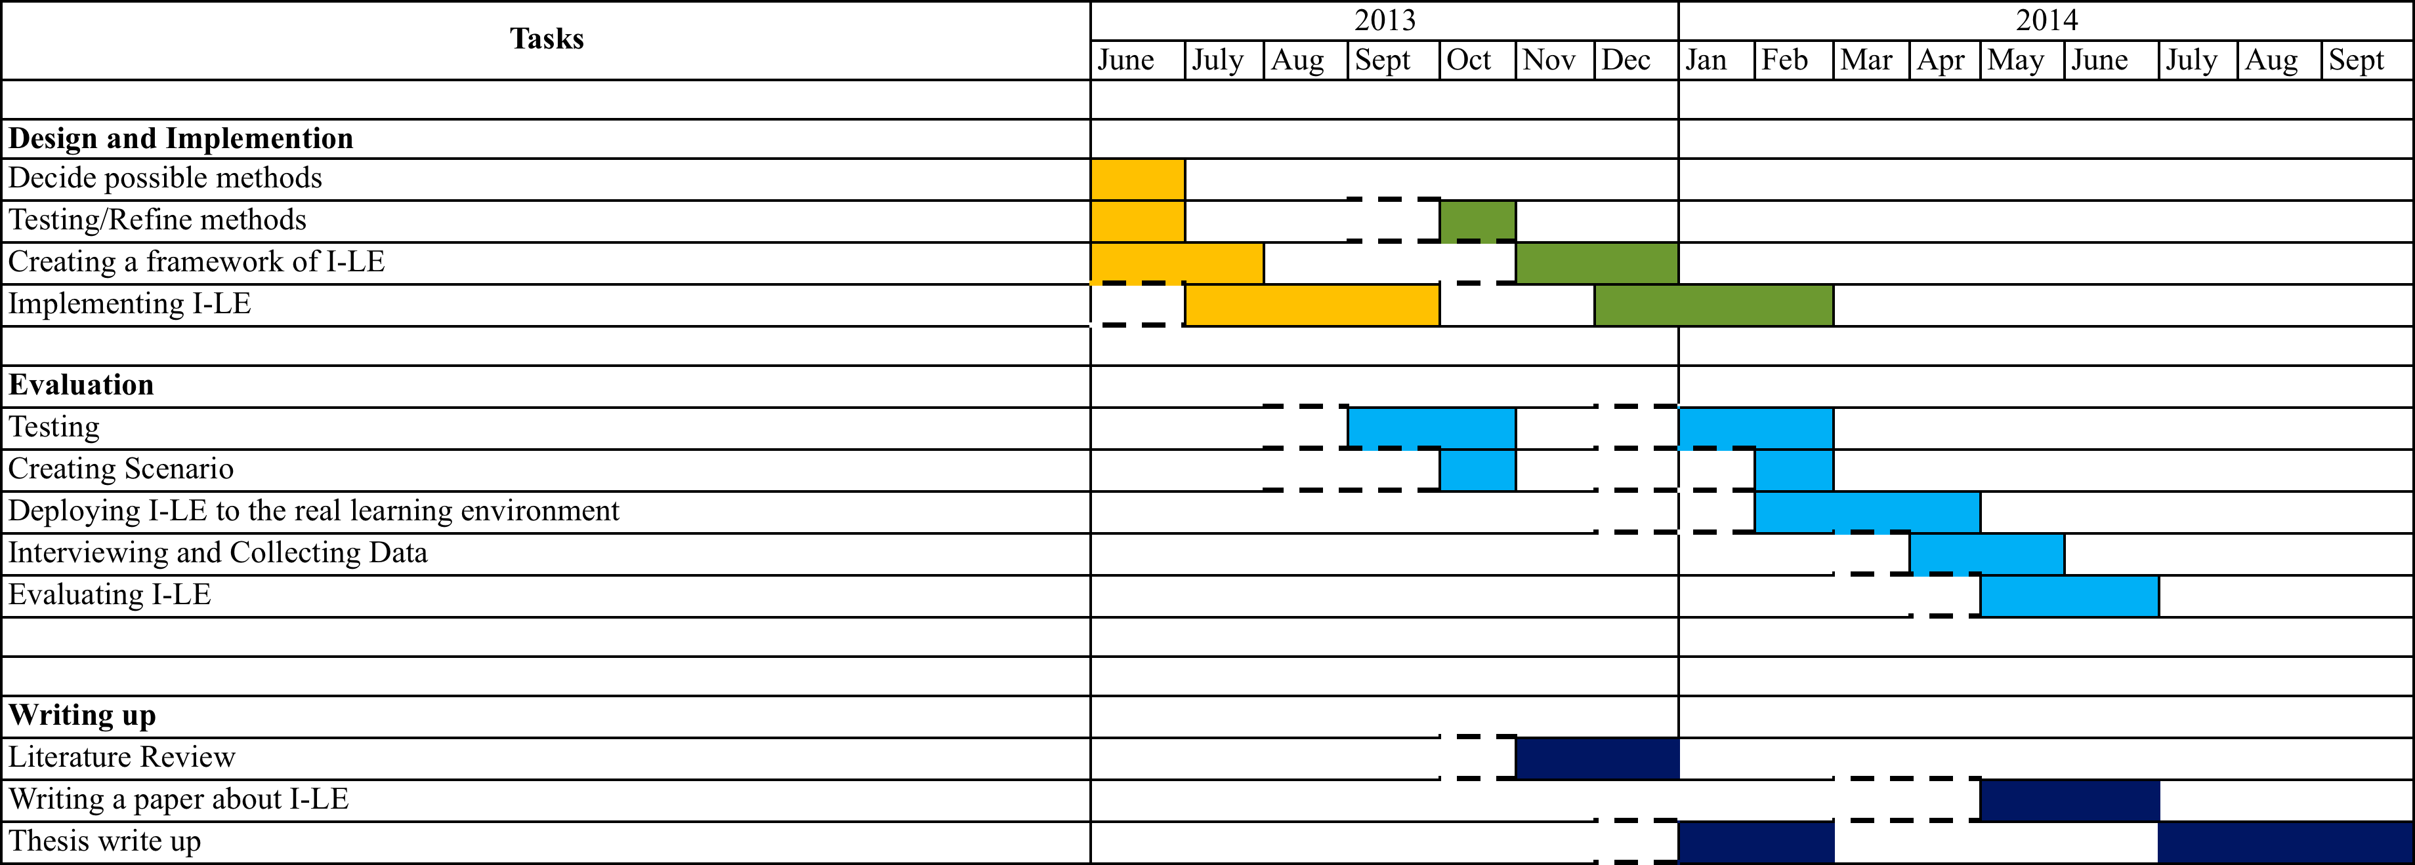
Plan

Slide 30
Thank you

Slide 31
Questions
How to deal with evaluation using a real environment?
Are there any suggestions on a student model?

